Slide 1
COMPUTER ORGANISTION
REGISTER TRANSFER LANGUAGE

Slide 2
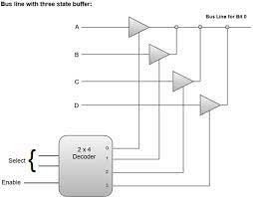
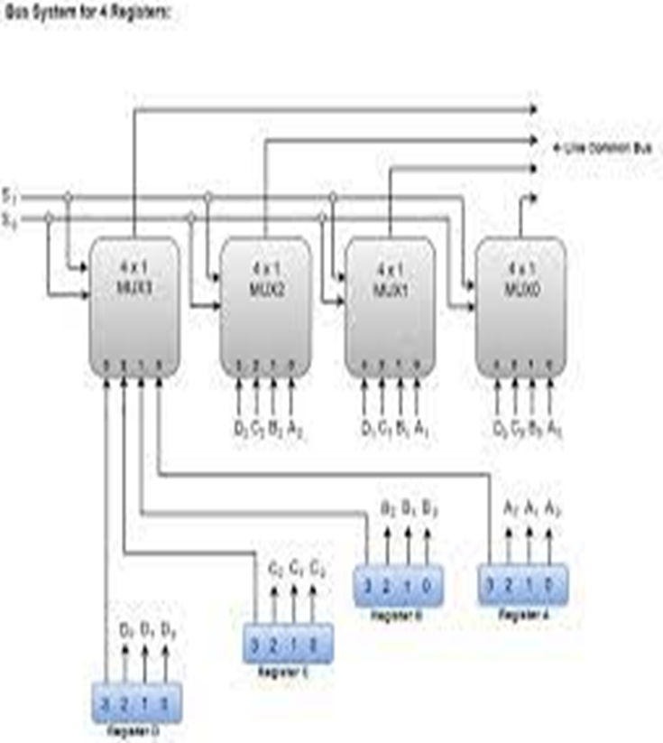
What Is Bus Transfer?
A computer consists of many registers and data paths, which are used for transferring the data from one register to another register. Consider that separate wires are used for linking registers, than the huge number of wires in the circuit will create a mess and increase the complexity of the system.

Slide 3
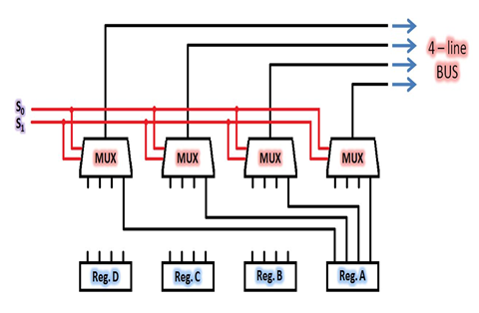
Bus Transfer
This issue is resolved by using common bus system in which, the information is transferred in multiple configuration register. In a bus structure, common lines are used where; each line is used for transferring each bit of the binary data at a time.

Slide 4
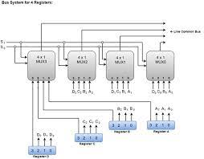
Bus And Memory Transfer

Slide 5

Types Of Bus Transfer
Parallel Bus: A parallel Bus can be created using MULTIPLEXERs. Several Multiplexers are connected in such a way that the output lines of all Multiplexers constitute the different lines of the Parallel Bus.

Slide 6
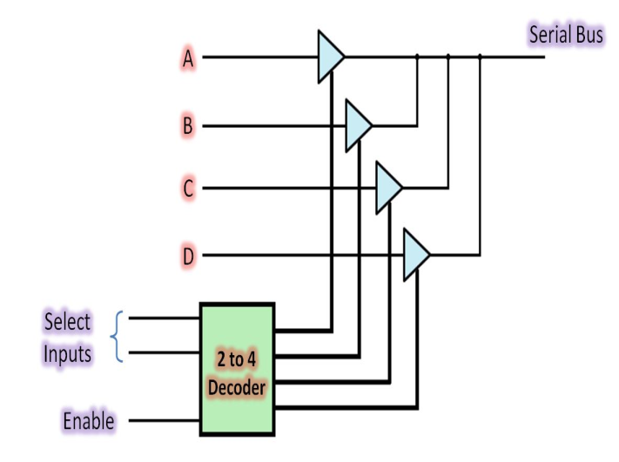
Types Of Bus Transfer
Serial Bus: A Serial Bus can be created using Decoders and 3-state Buffer gates. Several 3-state buffer gates are connected with each output of a Decoder. Logic behind using 3-state buffer Gates is to avoid chaos on the single line carrying several data back to back.

Slide 7
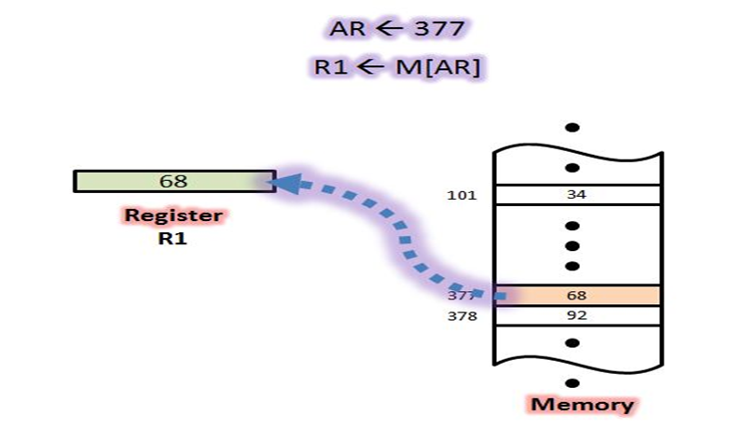
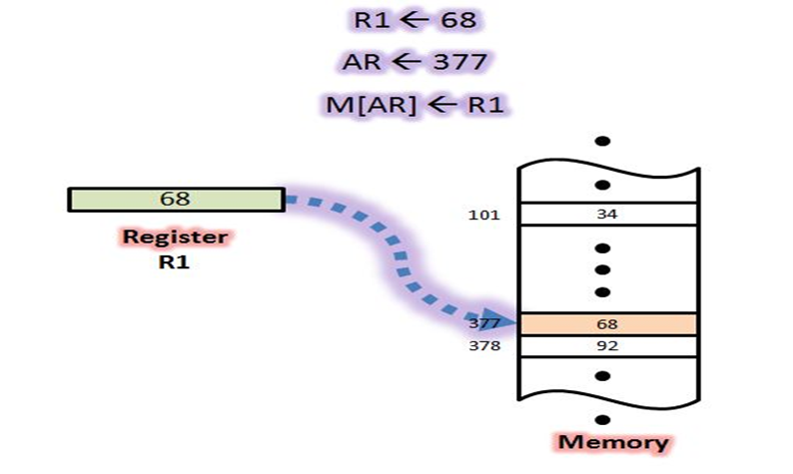
Memory Transfer
Memory transfers simply mean to a transfer from a specific location of memory to a register. However a memory transfer can be either ways. It can work either from Memory to Register or from Register to Memory.
A transfer from Memory to Register is called READ operation.
A transfer from Register to Memory is called WRITE operation.

Slide 8

Types Of Memory Transfer
Memory Read Operation: A memory read operation first searches for a location in the memory and then transfers the value located at that location to a register.

Slide 9
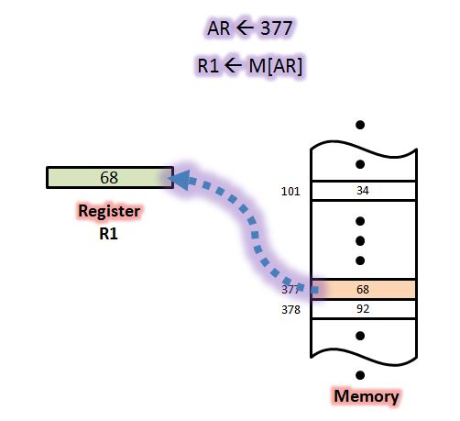
Types Of Memory Transfer
Memory Write Operation: A memory write operation simply extracts data from a register and transfers it to a memory location.

Slide 10


